Slide 1
Stratified Sampling
C

Slide 2
3.1 What Is Stratified Sampling?
The word stratify comes from Latin words stratum+facere, meaning “to make layers”; we divide the population into H subpopulations, called strata.
The strata do not overlap, and they constitute the whole population so that each sampling unit belongs to exactly one stratum.
If the variable we are interested in takes on different mean values in different subpopulations, we may be able to obtain more precise estimates of population quantities by taking a stratified random sample.
We draw an independent probability sample from each stratum, then pool the information to obtain overall population estimates.
Condensed from Sampling Design and Analysis 2e by S. Lohr

Slide 3
3.1 What Is Stratified Sampling?
We use stratified sampling for one or more of the following reasons:
1 We want to be protected from the possibility of obtaining a really bad sample.
  When taking an SRS of size 100 from a population of 1000 male and 1000 female students, obtaining a sample with no or very few males is theoretically possible, although such a sample is not likely to occur.
  Most people would not consider such a sample to be representative of the population and would worry that men and women might respond differently on the item of interest.
  In a stratified sample, you can take an SRS of 50 males and an independent SRS of 50 females, guaranteeing that the proportion of males in the sample is the same as that in the population.
  With this design, a sample with no or few males cannot be selected.
Condensed from Sampling Design and Analysis 2e by S. Lohr

Slide 4
3.1 What Is Stratified Sampling?
2 We may want data of known precision for subgroups of the population.
  These subgroups should be the strata.
3 A stratified sample may be more convenient to administer and may result in a lower cost for the survey.
  For example, sampling frames may be constructed differently in different strata, or different sampling designs or field procedures may be used.
  In a survey of businesses, an Internet survey might be used for large firms while a mail or telephone survey is used for small firms.
  In other surveys, a different procedure may be used for sampling households in urban strata than in rural strata.
Condensed from Sampling Design and Analysis 2e by S. Lohr

Slide 5
3.1 What Is Stratified Sampling?
4 Stratified sampling often gives more precise (having lower variance) estimates for population means and totals.
  Persons of different ages tend to have different blood pressures, so in a blood pressure study it would be helpful to stratify by age groups.
  If studying the concentration of plants in an area, one would stratify by type of terrain; marshes would have different plants than woodlands.
  Stratification works for lowering the variance because the variance within each stratum is often lower than the variance in the whole population.
  Prior knowledge can be used to save money in the sampling procedure.
Condensed from Sampling Design and Analysis 2e by S. Lohr

Slide 6
3.2 Theory of Stratified Sampling
We divide the population of N sampling units into H “layers” or strata, with N_{h} sampling units in stratum h.
For stratified sampling to work, we must know the values of N₁, N₂, . . . , N_{H}, and must have N₁ + N₂ + … +N_{H} = N, where N is the total number of units in the entire population.
In stratified random sampling, the simplest form of stratified sampling, we independently take an SRS from each stratum, so that n_{h} observations are randomly selected from the N_{h} population units in stratum h.
Condensed from Sampling Design and Analysis 2e by S. Lohr

Slide 7
3.2 Theory of Stratified Sampling
Define S_{h} to be the set of n_{h} units in the SRS for stratum h.
The total sample size is n = n₁ + n₂ + … +n_{H}.
Condensed from Sampling Design and Analysis 2e by S. Lohr

Slide 8
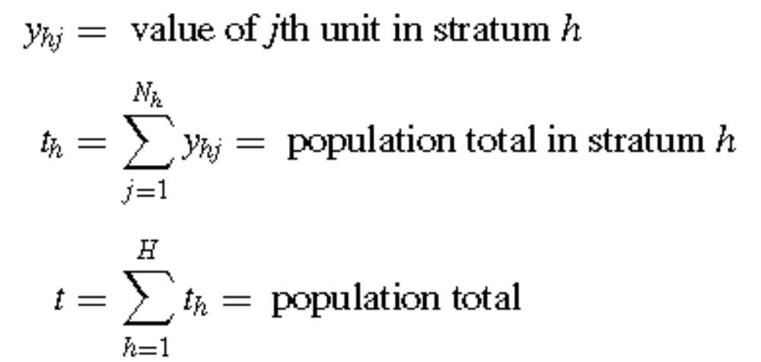
Notations: Population quantities
Condensed from Sampling Design and Analysis 2e by S. Lohr

Slide 9
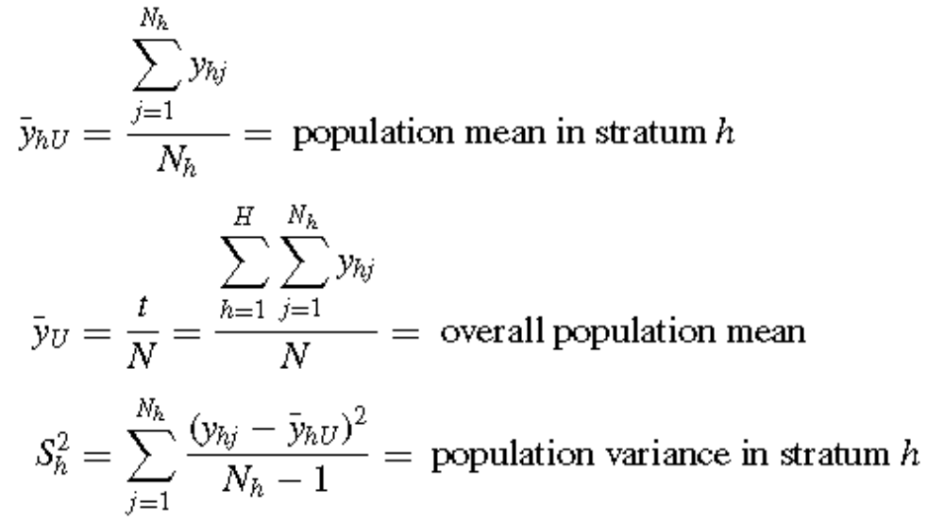
Notations: Population quantities
Condensed from Sampling Design and Analysis 2e by S. Lohr

Slide 10
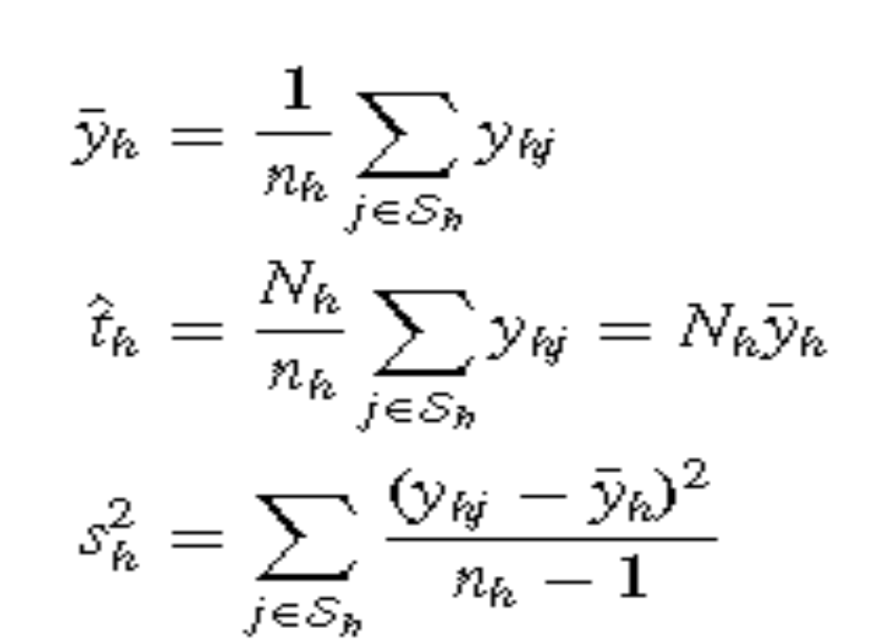
Notations: Sample quantities
Condensed from Sampling Design and Analysis 2e by S. Lohr

Slide 11

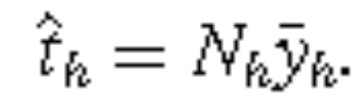
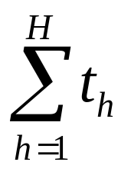

3.2 Theory of Stratified Sampling
Suppose we only sampled the hth stratum.
In effect, we have a population of N_{h} units and take an SRS of n_{h} units.
Then we would estimate and t_{h} by
The population total is t = , so we estimate t by
Condensed from Sampling Design and Analysis 2e by S. Lohr

Slide 12
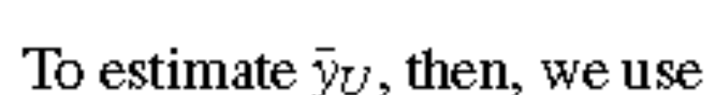


3.2 Theory of Stratified Sampling
This is a weighted average of the sample stratum averages; is multiplied by N_{h}/N, the proportion of the population units in stratum h.
To use stratified sampling, the sizes or relative sizes of the strata must be known.
Condensed from Sampling Design and Analysis 2e by S. Lohr

Slide 13
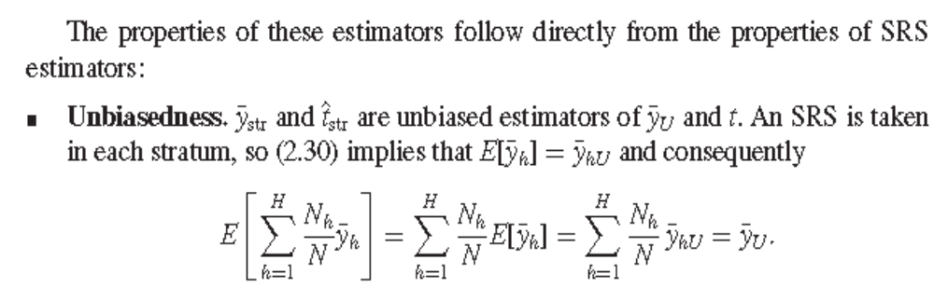
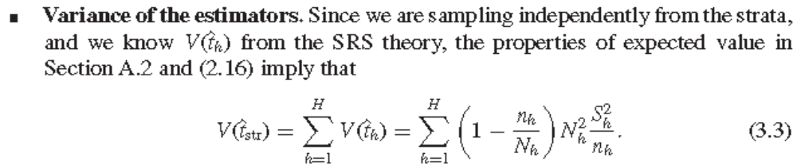
3.2 Theory of Stratified Sampling
Condensed from Sampling Design and Analysis 2e by S. Lohr

Slide 14
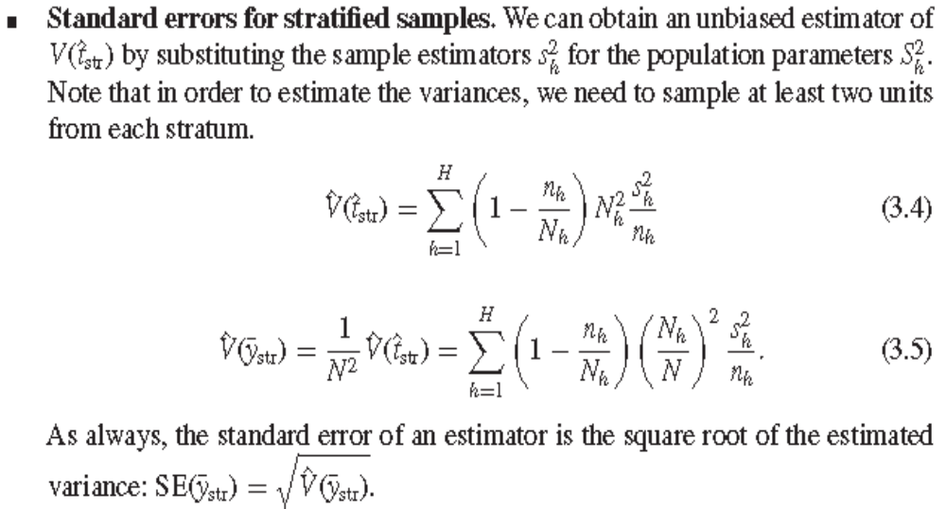
3.2 Theory of Stratified Sampling
Condensed from Sampling Design and Analysis 2e by S. Lohr

Slide 15
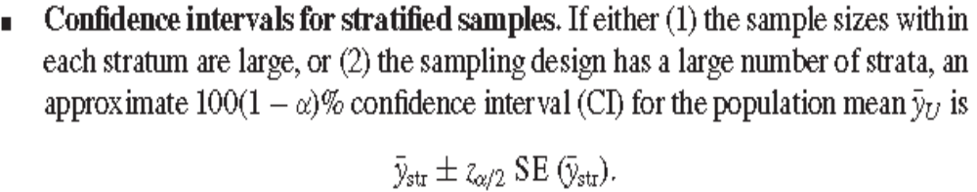
Condensed from Sampling Design and Analysis 2e by S. Lohr

Slide 16
See Example 3.3 p. 79
Condensed from Sampling Design and Analysis 2e by S. Lohr

Slide 17
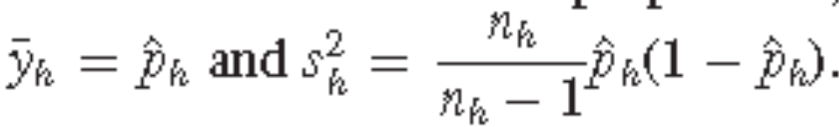
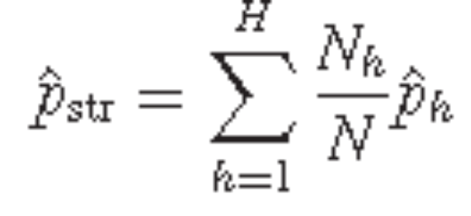
Stratified Sampling for Proportions
Recall: a proportion is the mean of a variable that takes on values 0 and 1.
To make inferences about proportions, we simply use the results in (3.1)–(3.5), with
Then
Condensed from Sampling Design and Analysis 2e by S. Lohr

Slide 18
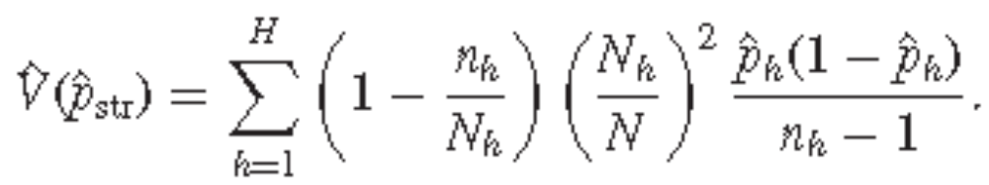
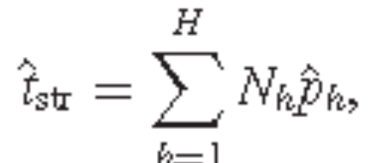
And
Estimating the total number of population units having a specified characteristic is similar:
so the estimated total number of population units with the characteristic is the sum of the estimated totals in each stratum.
Condensed from Sampling Design and Analysis 2e by S. Lohr

Slide 19
Similarly,
Condensed from Sampling Design and Analysis 2e by S. Lohr

Slide 20
SamplingWeights in Stratified Random
Sampling
Recall: For an SRS, the sampling weight for each observation is the same since all of the inclusion probabilities π_{i} are the same.
In stratified sampling, however we may have different inclusion probabilities in different strata so that the weights may be unequal for some stratified sampling designs.
Condensed from Sampling Design and Analysis 2e by S. Lohr

Slide 21
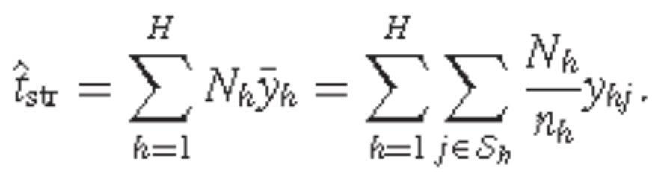
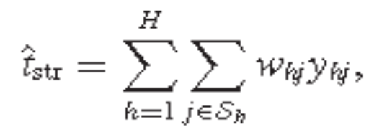
SamplingWeights in Stratified Random
Sampling
The stratified sampling estimator ˆt_{str} can be expressed as a weighted sum of the individual sampling units, using
Condensed from Sampling Design and Analysis 2e by S. Lohr

Slide 22
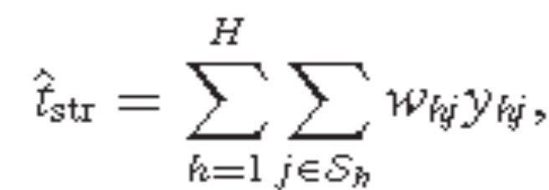
SamplingWeights in Stratified Random
Sampling
The estimator of the population total in stratified sampling may thus be written as
where the sampling weight for unit j of stratum h is wh_{j} = (N_{h}/n_{h}).
Condensed from Sampling Design and Analysis 2e by S. Lohr

Slide 23
SamplingWeights in Stratified Random
Sampling
The sampling weight can again be thought of as the number of units in the population represented by the sample member y_{hj} .
If the population has 1600 men and 400 women, and the stratified sample design specifies sampling 200 men and 200 women, then each man in the sample has weight 8 and each woman has weight 2.
Each woman in the sample represents herself and another woman not selected to be in the sample, and each man represents himself and seven other men not in the sample.
Condensed from Sampling Design and Analysis 2e by S. Lohr

Slide 24
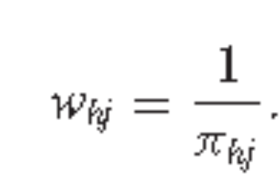
SamplingWeights in Stratified Random
Sampling
Note that the probability of including unit j of stratum h in the sample is π_{hj} = n_{h}/N_{h}, the sampling fraction in stratum h.
Thus, as before, the sampling weight is simply the reciprocal of the inclusion probability:
Condensed from Sampling Design and Analysis 2e by S. Lohr

Slide 25
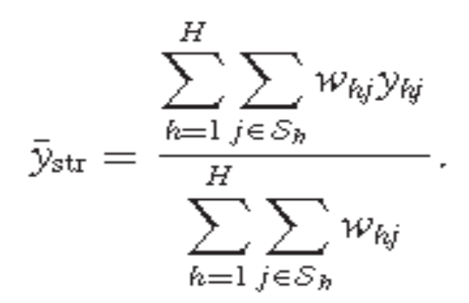
SamplingWeights in Stratified Random
Sampling
The sum of the sampling weights in stratified random sampling equals the population size N; each sampled unit “represents” a certain number of units in the population, so the whole sample “represents” the whole population. In a stratified random sample, the population mean is thus estimated by
Condensed from Sampling Design and Analysis 2e by S. Lohr

Slide 26
SamplingWeights in Stratified Random
Sampling
See Fig. 3.2 p. 83
A stratified sample is self-weighting if the sampling fraction n_{h}/N_{h} is the same for each stratum.
In that case, the sampling weight for each observation is N/n, exactly the same as in an SRS.
The variance of a stratified random sample, however, depends on the stratification, so (3.4) must be used to estimate the variance of ˆt_{str}.
Equation (3.4) requires that you calculate the variance separately within each stratum; the weights do not tell you the stratum membership of the observations.
Condensed from Sampling Design and Analysis 2e by S. Lohr

Slide 27
Allocating Observations to Strata
Designing the survey is the most important part of using a survey in research: If the survey is badly designed, then no amount of analysis will yield the needed information.
SRS involves one design feature: the sample size
For stratified random sampling, we need to design what the strata should be, then decide how many observations to sample in each stratum.
Condensed from Sampling Design and Analysis 2e by S. Lohr

Slide 28
Proportional Allocation
If you are taking a stratified sample in order to ensure that the sample reflects the population with respect to the stratification variable and you would like your sample to be a miniature version of the population, you should use proportional allocation when designing the sample.
In proportional allocation, so called because the number of sampled units in each stratum is proportional to the size of the stratum, the inclusion probability π_{hj} = n_{h}/N_{h} is the same (= n/N) for all strata.
Condensed from Sampling Design and Analysis 2e by S. Lohr

Slide 29
Proportional Allocation
If proportional allocation is used, each unit in the sample represents the same number of units in the population.
Proportional allocation thus results in a self-weighting sample
When the strata are large enough, the variance of under proportional allocation is usually at most as large as the variance of the sample mean from an SRS with the same number of observations.
  This is true no matter how silly the stratification scheme may be.
Condensed from Sampling Design and Analysis 2e by S. Lohr

Slide 30
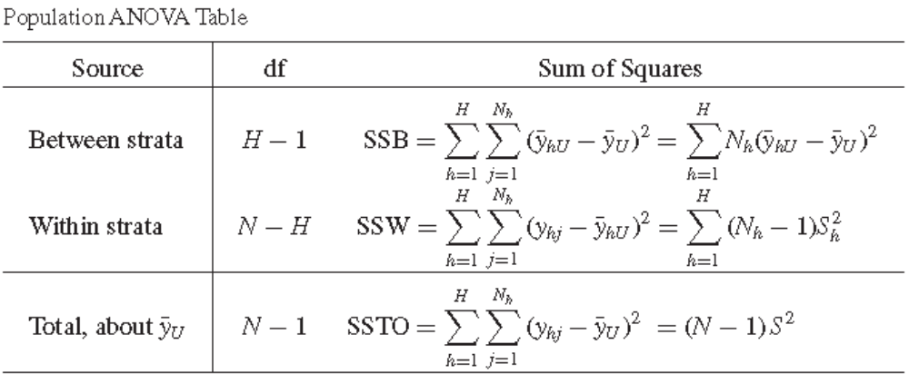
Proportional Allocation
Condensed from Sampling Design and Analysis 2e by S. Lohr

Slide 31
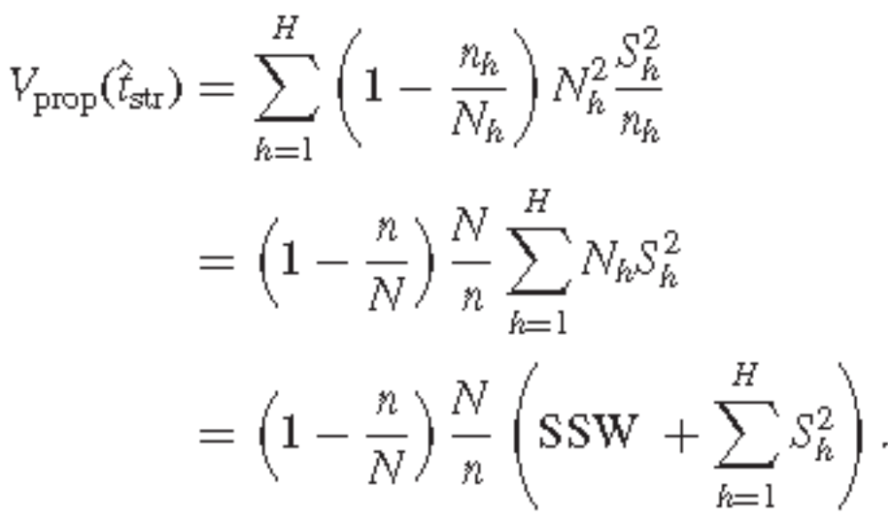
Proportional Allocation
In a stratified sample of size n with proportional allocation, since n_{h}/N_{h} = n/N,
Condensed from Sampling Design and Analysis 2e by S. Lohr

Slide 32
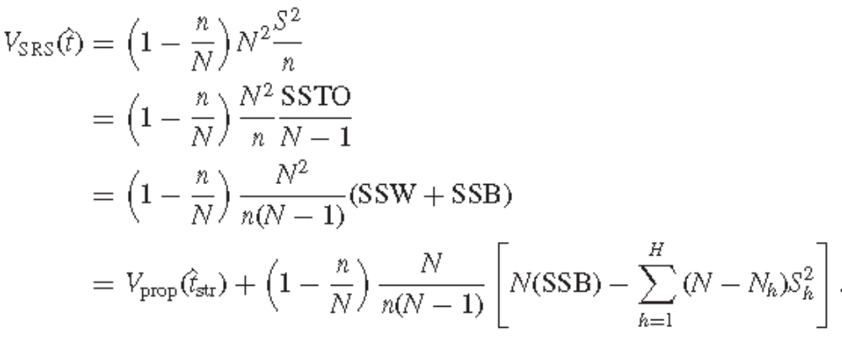
Proportional Allocation
Note that the variance of the estimated population total from an SRS of size n is
Condensed from Sampling Design and Analysis 2e by S. Lohr

Slide 33
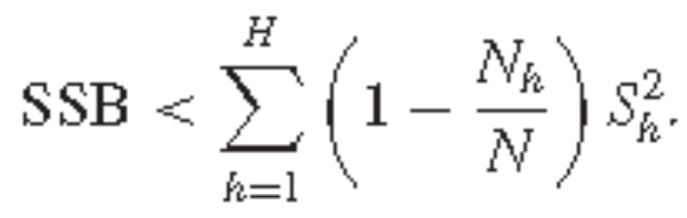

Proportional Allocation
The above result shows us that proportional allocation with stratification always gives smaller variance than SRS unless
which rarely happens when the N_{h} are large; generally, the large population sizes of the strata will force
Condensed from Sampling Design and Analysis 2e by S. Lohr

Slide 34
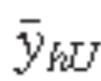
Proportional Allocation
In general, the variance of the estimator of t from a stratified sample with proportional allocation will be smaller than the variance of the estimator of t from an SRS with the same number of observations.
The more unequal the stratum means , the more precision you will gain by using proportional allocation.
Condensed from Sampling Design and Analysis 2e by S. Lohr

Slide 35

Proportional Allocation
The variance of depends primarily on SSW; since SSTO is a fixed value for the finite population, SSW is smaller when SSB is larger.
Of course, this result only holds for population variances; it is possible for a variance estimate from proportional allocation to be larger than that from an SRS merely because the sample selected had large within-stratum sample variances.
See Example 3.7 p. 87.
Condensed from Sampling Design and Analysis 2e by S. Lohr

Slide 36
Optimal Allocation
If the variances S_{h}² are more or less equal across all the strata, proportional allocation is probably the best allocation for increasing precision.
In cases where the S_{h}² vary greatly, optimal allocation can result in smaller costs.
In practice, when we are sampling units of different sizes, the larger units are likely to be more variable than the smaller units, and we would sample them with a higher sampling fraction.
Condensed from Sampling Design and Analysis 2e by S. Lohr

Slide 37
Optimal Allocation
For example, if we were to take a sample of corporations and our goal was to estimate the amount of trade with Europe, the variation among large corporations would be greater than the variation among small ones.
As a result, we would sample a higher percentage of the large corporations.
Condensed from Sampling Design and Analysis 2e by S. Lohr

Slide 38
Optimal Allocation
Optimal allocation works well for sampling units such as corporations, cities, and hospitals, which vary greatly in size.
It is also effective when some strata are much more expensive to sample than others.
The objective in optimal allocation is to gain the most information for the least cost.
Condensed from Sampling Design and Analysis 2e by S. Lohr

Slide 39
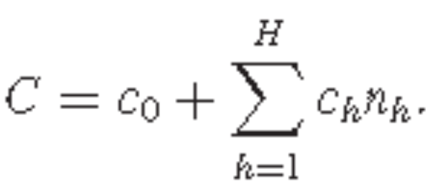

Optimal Allocation
An example of a simple cost function:
  Let C represent total cost, c₀ represent overhead costs such as maintaining an office, and c_{h} represent the cost of taking an observation in stratum h, so that
  We want to allocate observations to strata so as to minimize V( ) for a given total cost C, or, equivalently, to minimize C for a fixed V( ).
Condensed from Sampling Design and Analysis 2e by S. Lohr

Slide 40
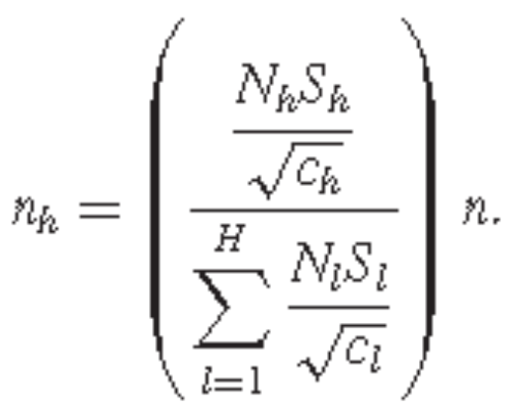
Optimal Allocation
Suppose that the costs c₁, c₂, . . . , c_{H} are known.
To minimize the total cost for a fixed variance, we can prove that the optimal allocation has n_{h} proportional to N_{h}S_{h} /√ c_{h} for each h.
Thus, the optimal sample size in stratum h is
Condensed from Sampling Design and Analysis 2e by S. Lohr

Slide 41
Optimal Allocation
We shall then sample heavily within a stratum if
  The stratum accounts for a large part of the population.
  The variance within the stratum is large; we sample more heavily to compensate for the heterogeneity.
  Sampling in the stratum is inexpensive.
Sometimes applying the optimal allocation formula results in one or more of the “optimal” n_{h}’s being larger than the stratum size N_{h} in those strata.
In that case, take a sample size of N_{h} in those strata, and then apply the optimal allocation formula again with the remaining strata.
Condensed from Sampling Design and Analysis 2e by S. Lohr

Slide 42

Optimal Allocation
See Example 3.9 p. 89
If all variances and costs are equal, proportional allocation is the same as optimal allocation.
If we know the variances within each stratum and they differ, optimal allocation gives a smaller variance for the estimator of than proportional allocation.
But optimal allocation is a more complicated scheme; often the simplicity and self-weighting property of proportional allocation are worth the extra variance.
Condensed from Sampling Design and Analysis 2e by S. Lohr

Slide 43
Optimal Allocation
In addition, the optimal allocation will differ for each variable being measured, whereas the proportional allocation depends only on the number of population units in each stratum.
Linear programming methods that can be used to determine optimal allocations when more than one variable is of interest.
Condensed from Sampling Design and Analysis 2e by S. Lohr

Slide 44
Optimal Allocation
Neyman allocation is a special case of optimal allocation, used when the costs in the strata (but not the variances) are approximately equal.
Under Neyman allocation, n_{h} is proportional to N_{h}S_{h}.
If the variances S_{h}² are specified correctly, Neyman allocation will give an estimator with smaller variance than proportional allocation
Condensed from Sampling Design and Analysis 2e by S. Lohr

Slide 45
Optimal Allocation
When the stratum variances S_{h}² are approximately known, Neyman allocation gives higher precision than proportional allocation.
If the information about the stratum variances is of poor quality, however, disproportional allocation can result in a higher variance than simple random sampling.
Proportional allocation, on the other hand, almost always has smaller variance than simple random sampling.
Condensed from Sampling Design and Analysis 2e by S. Lohr

Slide 46
Allocation for Specified Precision within Strata
Sometimes you are less interested in the precision of the estimate of the population total or mean for the whole population than in comparing means or totals among different strata.
In that case, you would determine the sample size needed for the individual strata using the guidelines used for SRS.
See Example 3.11 p. 90.
Condensed from Sampling Design and Analysis 2e by S. Lohr

Slide 47
Determining Sample Sizes
The different methods of allocating observations to strata give the relative sample sizes n_{h}/n.
After strata are constructed and observations allocated to strata, Equation (3.3) can be used to determine the sample size necessary to achieve a prespecified margin of error.
Condensed from Sampling Design and Analysis 2e by S. Lohr

Slide 48
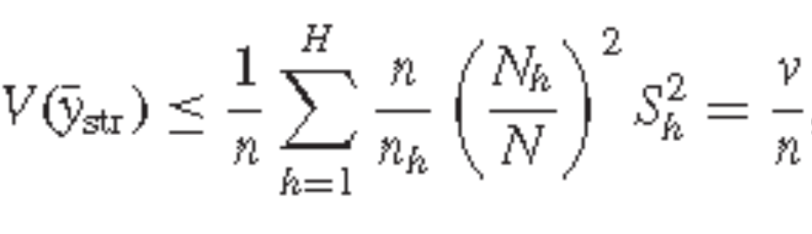

Determining Sample Sizes
Recall that
Thus, if the fpc’s can be ignored and if the normal approximation is valid, an approximate 95% CI for the population mean will be
Set n = z_{α/2}²/e² to achieve a desired margin of error e.
We substitute v for S² in the sample size (without fpc) to obtain the necessary sample size for stratified sampling.
If sampling fractions in the strata are high, this sample size can be adjusted for the finite population corrections.
Condensed from Sampling Design and Analysis 2e by S. Lohr

Slide 49
Defining Strata
Q: Since stratified sampling almost always gives higher precision than simple random sampling, why anyone would ever take a sample that is not stratified?
A: Stratification adds complexity to the survey, and the added complexity may not be worth a small gain in precision.
  In addition, we need to have information in the sampling frame that can be used to form the strata.
  For each stratum, we need to know how many and which members of the population belong to that stratum.
When such information is available, however, stratification is often well worth the effort.
Condensed from Sampling Design and Analysis 2e by S. Lohr

Slide 50
Defining Strata
Stratification is most efficient when the stratum means differ widely; then
  the between sum of squares is large, and
  the variability within strata will be smaller.
Consequently, when constructing strata we want the strata means to be as different as possible.
Ideally, we would stratify by the values of y; if our survey is to estimate total business expenditures on advertising, we would like to put businesses that spent the most on advertising in stratum 1, businesses with the next highest level of advertising expenditures in stratum 2, and so on, until the last stratum contained businesses that spent nothing on advertising.
Condensed from Sampling Design and Analysis 2e by S. Lohr

Slide 51
Defining Strata
The problem with this scheme is that we do not know the advertising expenditures for all the businesses while designing the survey—if we did, we would not need to do a survey at all!
Instead, we try to find some variable closely related to y.
For estimating total business expenditures on advertising, we might stratify by number of employees or size of the business and by the type of product or service.
For farm production, we might use the size of the farm as a stratifying variable, since we expect that larger farms would have higher productions.
Condensed from Sampling Design and Analysis 2e by S. Lohr

Slide 52
Defining Strata
Most surveys measure more than one variable, so any stratification variable should be related to many characteristics of interest.
If several stratification variables are available, use the variables associated with the most important responses.
Condensed from Sampling Design and Analysis 2e by S. Lohr

Slide 53
Defining Strata
The number of strata you choose depends upon many factors such as
  the difficulty in constructing a sampling frame with stratifying information, and
  the cost of stratifying.
A general rule to keep in mind is: The more information, the more strata you should use.
Thus, you should use an SRS when little prior information about the target population is available.
Condensed from Sampling Design and Analysis 2e by S. Lohr

Slide 54
Defining Strata
You can often collect preliminary data that can be used to stratify your design.
If you are taking a survey to estimate the number of fish in a region, you can use physical features of the area that are related to fish density, such as depth, salinity, and water temperature.
Or you can use survey information from previous years, or data from a preliminary cruise to aid in constructing strata.
Condensed from Sampling Design and Analysis 2e by S. Lohr

Slide 55
Defining Strata
In a survey with more precise prior information, we will want to use more strata—many surveys are stratified to the point that only two sampling units are observed in each stratum.
For many surveys, stratification can increase precision dramatically, and often well repays the effort used in constructing the strata.
Assignment: Read Example 3.12.
Condensed from Sampling Design and Analysis 2e by S. Lohr

Slide 56
Model-Based Inference for Stratified
Sampling
The one-way ANOVA model with fixed effects provides an underlying structure for stratified sampling.
Here, Y_{hj} = μ_{h} + ε_{hj} , (3.15)
where the ε_{hj}’s are independent with mean 0 and variance σ_{h}² .
Then the least squares estimator of μ_{h} is , the average in stratum h.
Condensed from Sampling Design and Analysis 2e by S. Lohr

Slide 57
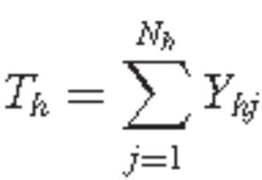
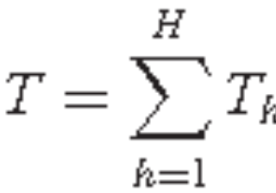
Model-Based Inference for Stratified
Sampling
Let the random variable represent the
total in stratum h and the random variable
represent the overall total.
Condensed from Sampling Design and Analysis 2e by S. Lohr

Slide 58
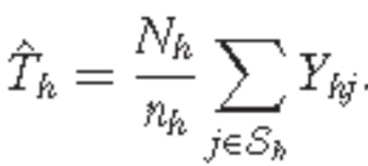
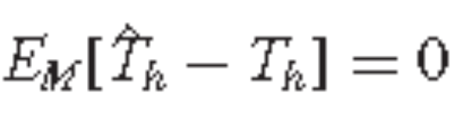
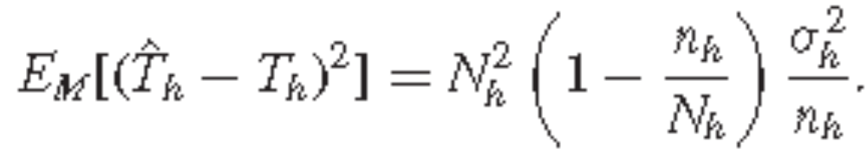
Model-Based Inference for Stratified
Sampling
Results from SRS show the best linear unbiased estimator for T_{h} is
Then and
Condensed from Sampling Design and Analysis 2e by S. Lohr

Slide 59
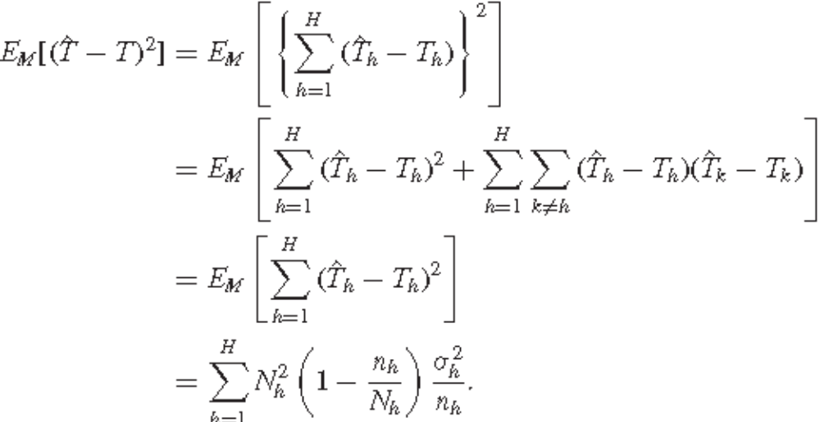
Model-Based Inference for Stratified
Sampling
Since observations in different strata are independent under the model
Condensed from Sampling Design and Analysis 2e by S. Lohr

Slide 60
Model-Based Inference for Stratified
Sampling
The theoretical variance σ_{h}² can be estimated by s_{h}².
Adopting the model in (3.15) results in the same estimators for t and its standard error as found under randomization theory in (3.5).
If a different model is used, however, then different estimators are obtained.
Condensed from Sampling Design and Analysis 2e by S. Lohr

Slide 61
Quota Sampling
Many samples that masquerade as stratified random samples are actually quota samples.
In quota sampling, the population is divided into different subpopulations just as in stratified random sampling, but with one important difference: Probability sampling is not used to choose individuals in the subpopulation for the sample.
Condensed from Sampling Design and Analysis 2e by S. Lohr

Slide 62
Quota Sampling
In extreme versions of quota sampling, choice of units in the sample is entirely at the discretion of the interviewer, so that a sample of convenience is chosen within each subpopulation.
In quota sampling, specified numbers (quotas) of particular types of population units are required in the final sample.
Thus, quota sampling is not a form of probability sampling—we do not know the probabilities with which each individual is included in the sample.
Condensed from Sampling Design and Analysis 2e by S. Lohr

Slide 63
Quota Sampling
It is often used when probability sampling is impractical, overly costly, or considered unnecessary, or when the persons designing the sample just do not know any better.
The big drawback of quota sampling is that we do not know if the units chosen for the sample exhibit selection bias.
If selection of units is totally up to the interviewer, she or he is likely to choose the most accessible members of the population—for instance, persons who are easily reached by telephone, households without menacing dogs, or areas of the forest close to the road.
Condensed from Sampling Design and Analysis 2e by S. Lohr

Slide 64
Quota Sampling
The most accessible members of a population are likely to differ in a systematic way from less accessible members.
Thus, unlike in stratified random sampling, we cannot say that the estimator of the population total from quota sampling is unbiased over repeated sampling—one of our usual criteria of goodness in probability samples.
In fact, in quota samples, we cannot measure sampling error over repeated samples and we have no way of estimating the bias from the sample data.
Since selection of units is up to the individual interviewer, we cannot expect that repeating the sample will give similar results.
Condensed from Sampling Design and Analysis 2e by S. Lohr

Slide 65
Quota Sampling
Thus, anyone drawing inferences from a quota sample must necessarily take a model-based approach.
Example: In the 1948 U.S. presidential elections, all of the major polls printed just a few days before the election predicted that Dewey would defeat Truman handily
Condensed from Sampling Design and Analysis 2e by S. Lohr

Slide 66

Truman won!
Condensed from Sampling Design and Analysis 2e by S. Lohr

Slide 67
Quota Sampling
While quota sampling is not as good as probability sampling under ideal conditions, it may give better results than a completely haphazard sample because it at least forces the inclusion of members of the different quota groups.
Quota samples have the advantage of being less expensive than probability samples.
The quality of the data from quota samples can be improved by allowing the interviewer less discretion in the choice of persons or households to be included in the sample.
Condensed from Sampling Design and Analysis 2e by S. Lohr

Slide 68
Quota Sampling
Many survey organizations use probability sampling along with quotas; they use probability sampling to select small blocks of potential respondents, and then take a quota sample within each block, using variables such as age and gender.
Because we do not know the probabilities with which units were sampled, we must take a model-based approach, and make strong assumptions about the data structure, when analyzing data from a quota sample.
The model generally adopted is:within each subclass the random variables generating the subpopulation are assumed independent and identically distributed.
Condensed from Sampling Design and Analysis 2e by S. Lohr

Slide 69
Quota Sampling
Such a model implies that any selection of units from the quota class will give a representative sample; if the model holds, then quota sampling will likely give good estimates of the population quantity.
If the model does not hold, then the estimates from quota sampling may be badly biased.
Example 3.14 p. 98
Condensed from Sampling Design and Analysis 2e by S. Lohr

Slide 70
Quota Sampling
Quota samples may be useful for market research- when the organization requesting the survey is aware of the model being used.
Persons collecting official statistics about crime, unemployment, or other matters that are used for setting public policy should use probability samples, however.
Quota samples, while easier to collect than a probability sample, suffer from the same disadvantages as other convenience samples.
Condensed from Sampling Design and Analysis 2e by S. Lohr

Slide 71
Quota Sampling
Some survey organizations now use quota sampling to recruit volunteers for online surveys; they accumulate respondents until they have specified sample sizes in the desired demographic classes.
In such online surveys, the respondents in each quota class are self-selected—if, as argued by Couper (2000), Internet users who volunteer for such surveys differ from members of the target population in those quota classes, results will be biased.
Condensed from Sampling Design and Analysis 2e by S. Lohr

Slide 72
End of Chap. 3
Coverage of first exam:
From beginning up to end of Chapter 3
C

